Slide 1

StreetCare AI
Pothole & street defect report review platform
AI-assisted screening, prediction and decision support for a borough council
TEAM
Mansavi Aggarwal · Puttamaneni Srinivasa Praneeth · Riya Rajeev Shinde
Bhavesh Durai S · Parvathy Vinod K V

Slide 2

Agenda
01
Problem statement and what we built
02
Architecture and system design
03
Data pipeline and ML models
04
Knowledge base (RAG) and screening
05
Agentic workflow and human decision
06
API, dashboard and testing
07
Team, live demo and closing
2

Slide 3

Problem statement
Wrenford Borough Council's Street Care Office reviews every pothole and street defect report by hand
3
channels
5
defect types
40
open reports
3
decisions
website · app · contact centre
each with its own standard
waiting in the live queue
order · inspect · refer
Why the review is hard today
What the Street Care Office needs
1
Every standard is different
a 30 mm hole meets the footway standard but not carriageway
Consistent
screen every report against its own standard, the same way every time
2
Forms arrive messy
references written 3 ways, 227 spellings, mm / cm / inches mixed
Predictive
estimate repeat likelihood and crew hours from 38,000 past reports
3
Context changes the answer
Explained
plain-language reasons the inspector can check
live street works or a busy road mean coordination first
4
Documents can disagree
Accountable
a Highways Inspector – never the AI – takes the decision
a resident's note may give a depth different from the form
5
Two questions no form answers
Complete
works order, resident update and a full audit trail
will the defect come back? how many crew hours will it take?
3

Slide 4
What we built
One platform covering the Street Care Office review desk, end to end
01
02
03
04
Data pipeline
3 ML models
Knowledge base
Screening engine
110,172 rows cleaned to 105,808
repeat · crew hours · sentence
16 PDFs → 205 passages
rules read from the standards
pandas · Decimal
scikit-learn
ChromaDB · RAG
pure Python
05
06
07
08
Agent workflow
Street care chat
REST API
Dashboard
7 agents + human decision gate
grounded, role-aware answers
11 endpoints, 3 security checks
5 pages, one per task
LangGraph · Gemini
RAG · Gemini
FastAPI
Streamlit
4

Slide 5
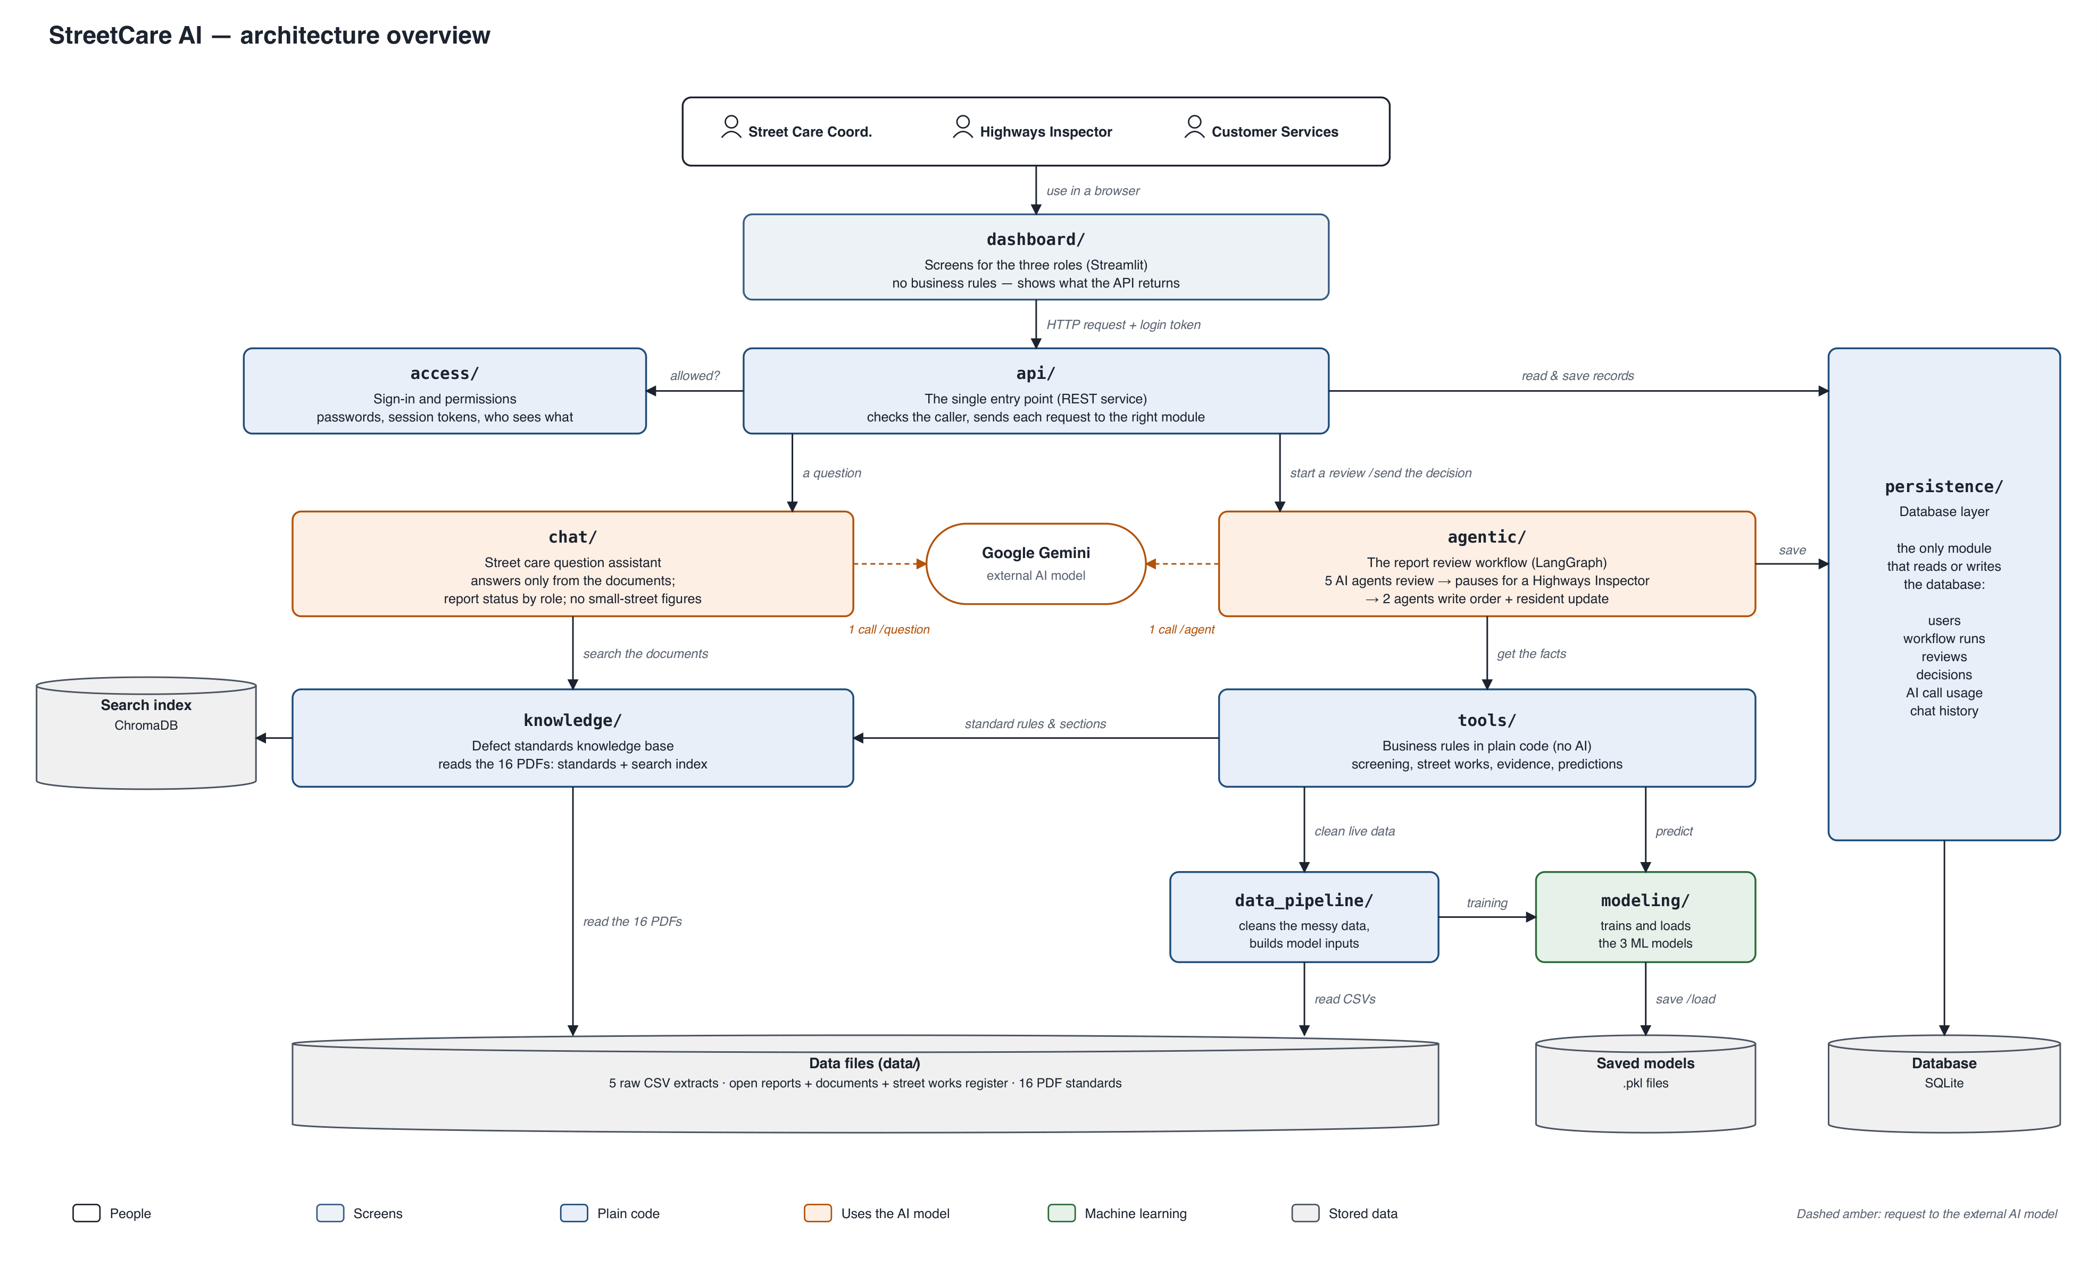
Solution architecture
People → dashboard → API → AI workflow and tools → knowledge, models and database
5

Slide 6
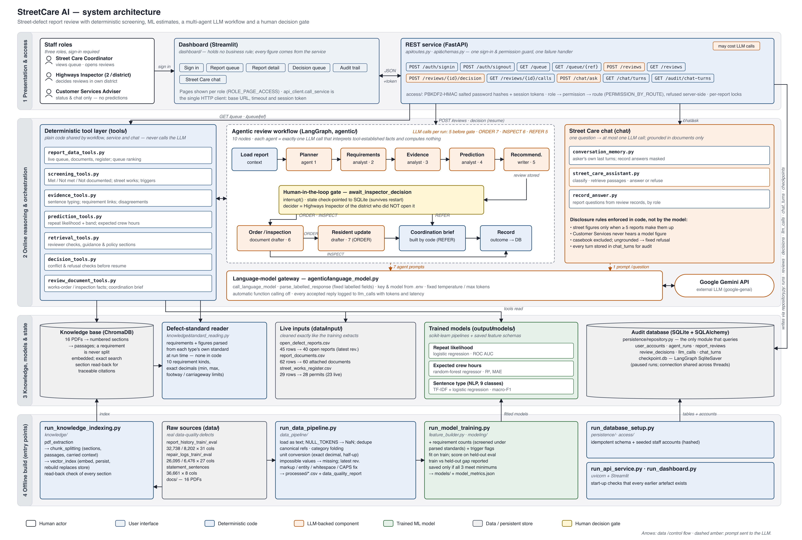
System architecture in detail
Four layers: presentation & access · online reasoning · knowledge, models & state · offline build
6

Slide 7

Data
Layer 1 · cleaning five messy extracts

Slide 8
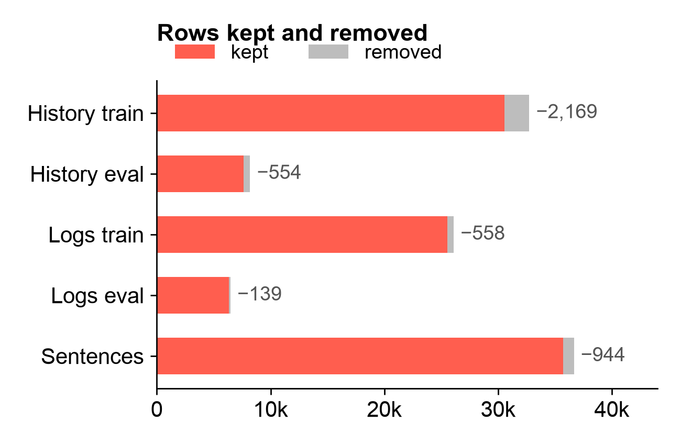
Data received
Five raw training extracts, three live files and sixteen council PDFs
Dataset | Raw rows | Kept | Feeds
Report history – train | 32,738 | 30,569 | Repeat model
Report history – eval | 8,202 | 7,648 | Repeat (held out)
Repair logs – train | 26,095 | 25,537 | Crew hours model
Repair logs – eval | 6,476 | 6,337 | Crew hours (held out)
Statement sentences | 36,661 | 35,717 | Sentence model
Live: reports · docs · permits | 45 · 62 · 29 | 40 · 60 · 28 | Live queue
Council PDFs | 16 | 205 passages | Knowledge base
Defects found in the raw files
369 exact duplicates
'-', 'n/a', 'not known' as missing
SC0052125 · SC-52125 · 52125
227 category spellings
mm / cm / in · m / ft · hrs / min
impossible readings
older revisions of a report
HTML markup · ALL CAPS
8

Slide 9
Cleaning techniques and results
Configuration-driven, exact arithmetic, refuses ambiguous data instead of guessing
1
Null tokens
2
Duplicates
3
References
110,172
rows received
'-', 'N/A' → missing
identical rows removed
SC-52125 → SC0052125
105,808
rows kept
4
Categories
5
Units
6
Exact rounding
'road surface' → Carriageway
1.75 in → 44 mm
3.95 cm → 40 mm
4,364
rows removed, each with a reason
7
Range limits
8
Revisions
9
Text
0
reports shared between train and eval
impossible → blank
latest revision only
markup and capitals fixed
Refuse, never guess a missing or repeated identifier, or an unreadable value, stops the pipeline with a message naming the column and rows.
Same code everywhere the live queue is cleaned by the same functions at service start, so training and prediction see identical values.
Evidence every count is written to output/data_quality_report.json.
9

Slide 10
ML Models
Layer 2 · predict and classify, never decide

Slide 11
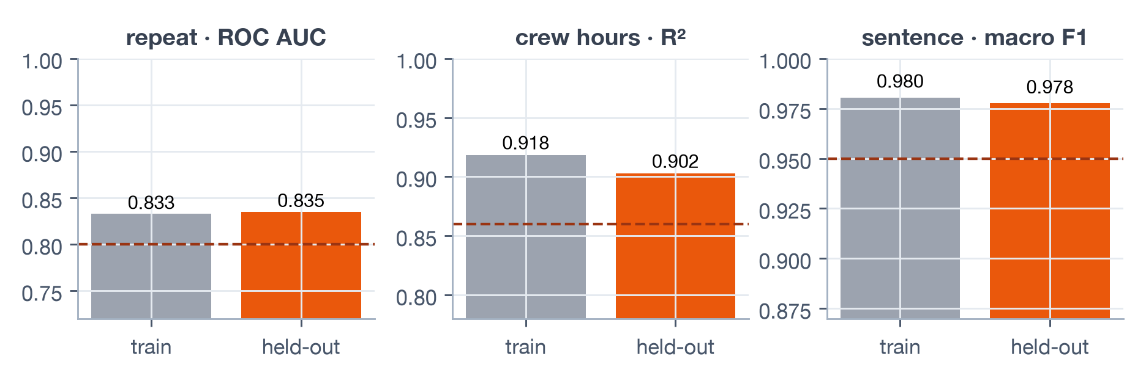
Three models
Each answers one business question and must beat its minimum on held-out data before it is saved
Repeat likelihood
Expected crew hours
Sentence type
Will the defect come back after repair?
How long will the repair take?
What does each document sentence say?
Algorithm
Logistic Regression
Algorithm
Random Forest, 300 trees
Algorithm
TF-IDF + Logistic Regression
Output
HIGH / MEDIUM / LOW band
Output
overrun if > 1.3 × planned
Output
evidence for each requirement
Held-out
ROC AUC 0.835
Held-out
R² 0.902
Held-out
macro F1 0.978
Safeguards
• Same feature code at training and prediction
• 3 requirement counts + 3 trigger flags
• Gaps filled inside the pipeline
• Outcome columns excluded
• Nothing saved below a minimum
11

Slide 12
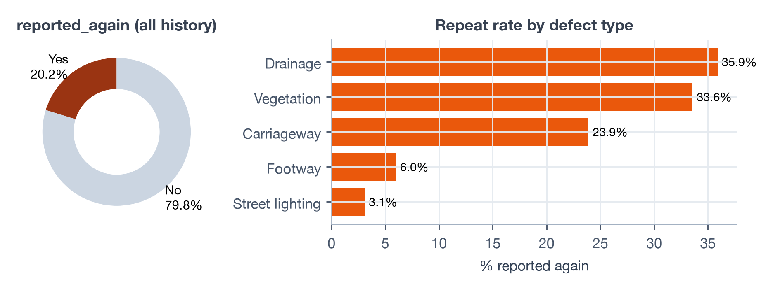
What the data shows and model benchmarking
Findings that drive the features, and 10 alternatives tuned with 5-fold cross-validation
Task | Candidate | CV | Held-out
Repeat | Hist. Gradient Boosting | 0.834 | 0.838
Repeat | Logistic Regression | 0.832 | 0.835
Repeat | Random Forest | 0.830 | 0.836
Crew hours | Extra Trees | 0.902 | 0.908
Crew hours | Hist. Gradient Boosting | 0.904 | 0.907
Crew hours | Random Forest | 0.904 | 0.911
Crew hours | Ridge | 0.859 | 0.870
Sentence | TF-IDF + Linear SVC | 0.980 | 0.977
Sentence | TF-IDF + ComplementNB | 0.979 | 0.975
Sentence | TF-IDF + Logistic Regression | 0.980 | 0.977
20%
14% → 69%
of repaired defects come back
repeat rate with 0 vs 3 earlier reports
19% → 51%
36%
with conflicting street works
of repairs exceed 1.3 × planned hours
All 10 clear every minimum; production models kept for calibration, explainability and size.
12

Slide 13
Knowledge Base
Layer 3 · RAG over 16 council documents

Slide 14
The council's documents are the rulebook
Every threshold is read from the PDFs at run time – a changed document changes the rule, with no code change
Requirements per defect standard (section 4)
What is in the knowledge base
Defect type | Requirements read from its own standard
Carriageway | location fixed · photograph · depth ≥ 40 mm · width 150–1500 mm
Footway | location fixed · photograph · depth ≥ 20 mm · width 150–1500 mm
Drainage | location fixed · photograph · water depth ≥ 50 mm · water reach ≥ 1 m
Vegetation | location fixed · highway land · clear height < 2.4 m / 5.1 m
Street lighting | location fixed · column number · column lean ≥ 5°
Documents | Sections read
5 defect standards | §2 · §4 · §6 · §7 · §8
8 statement guides | §3 reviewer checks
Highways Policy | §6 · §7 · §8
Report Rules | chat answers
Decisions casebook | never searched
16
136
205
0.64
PDFs
sections
passages
max distance
standards, guides, policy, rules
cut at numbered headings
whole sentences ≤ 700 characters
chat answers only when grounded
14

Slide 15
Knowledge base flow: index once, read rules every run
A · indexing (run_knowledge_indexing.py) · B · reading a standard · C · two ways the index is used
A · Indexing (run once)
16 PDFs
Extract text
Numbered sections
Passages
Embed
ChromaDB
cosine · 205 passages
data/docs
pypdf, header removed
'1. Heading' → 136
700 chars · 120 overlap
all-MiniLM-L6-v2 · CPU
Each passage keeps document · section number · passage number · characters carried over, so a section can be rebuilt exactly.
B · Reading a standard (every run)
C · Two ways the index is used
1
§2 the defect type
read_document_section
'The defect type is Carriageway.' – a standard of another type is refused
exact lookup by metadata
rules, reviewer checks, works order and resident update guidance, policy sections – used by the tools and agents
2
§4 requirement sentences
each sentence matched to a known kind; limits parsed as exact Decimals
search_documents
Rule used by the screening
similarity search – chat only
3
2 searches per question, 4 nearest passages, casebook excluded, answer only if distance ≤ 0.64
Carriageway: depth ≥ 40 mm · width 150–1500 mm
15

Slide 16
Screening Engine
Layer 4 · deterministic rules, no AI

Slide 17
Screening, triggers and assessment
Pure code with exact comparisons – the same report always gets the same answer
1 Each requirement gets a result
3 Assessment and decisions left open
Met
the answer meets the rule (boundaries inclusive)
Any requirement Not met or Not documented?
INSPECT ON SITE
Not met
the answer is given but fails the rule
open: inspect · refer
Not documented
a needed answer is blank
Otherwise, any coordination trigger?
REFER FOR COORDINATION
open: inspect · refer
2 Coordination triggers
Otherwise
ORDER REPAIR
Trigger | Applies when
Live street works | a Live permit on the same highway part
Traffic-sensitive street | carriageway or drainage, not a local road
High column | street lighting, column blank or > 8 m
open: order · inspect · refer
Live queue of 40 reports
13
18
9
order repair
inspect on site
refer
17

Slide 18
Agentic Workflow
Layer 5 · LangGraph agents + human gate

Slide 19
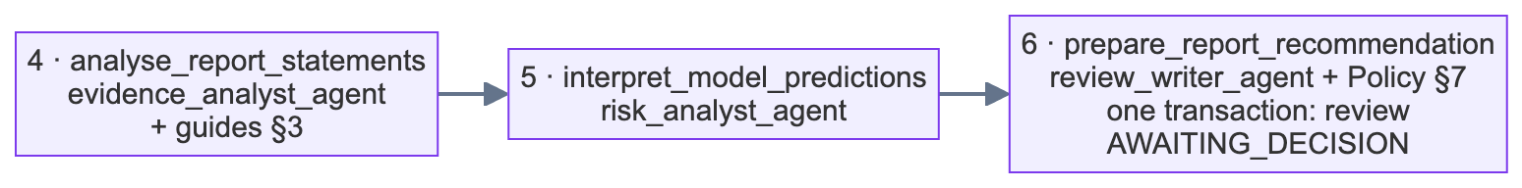
The ten-node review workflow
A LangGraph state machine – tools gather the facts, five agents interpret them, the run pauses for a Highways Inspector, then up to two writers
tools – no LLM call
agent – one Gemini call
human gate – run paused
outcome recorded
ORDER REPAIR · 5 + 2 = 7 calls
INSPECT ON SITE · 5 + 1 = 6 calls
REFER FOR COORDINATION · 5 + 0 = 5 calls
Exactly two conditional branches, both chosen by route_report_decision · purple nodes cost one LLM call each
19

Slide 20
The human decision gate
The AI recommends; a Highways Inspector decides – and every check runs before a single AI call is spent
ORDER REPAIR
INSPECT ON SITE
REFER FOR COORDINATION
open only when every requirement is met and no trigger applies
open for every report
open for every report
• works order to the repair contractor
• update for the resident who reported it
• inspection request: what to measure and settle
• coordination brief built by code – no AI
status recorded
7
status recorded
6
status recorded
5
REPAIR_ORDERED
INSPECTION_REQUESTED
REFERRED_FOR_COORDINATION
AI calls in all
AI calls in all
AI calls in all
Checks before the run resumes
403
not a Highways Inspector
403
street outside own district
409
opened the review themselves
409
decision not open
409
already decided
422
reason under 10 characters
20

Slide 21
Street care chat
One Gemini call per question – answers only from the documents or the records, within what the role may hear
1
Question
2
Recall
3
Search
4
Classify
5
Answer
3–1000 characters
own last 3 turns
2 searches · 4 passages
1 Gemini call · 7 types
documents · records · refuse
Standards · rules · guides
Report status / prediction
answered from the documents, only if the nearest passage is within 0.64; sources cited
answered by code from the review record – the model never sees the record
Street figure
Anything else
counted from decided history; under 5 reports → privacy line
refused; every turn saved to chat_turns
Who asks | Report status | Will it come back? / how long?
Customer Services Adviser | status; once ordered, where and what the resident was told | never told – a fixed sentence
Inspector / Coordinator | full six-line review record | the same review record with both figures
Examples
High Street footway → “801 defects reported”
Kiln Lane footway (2 reports) → privacy line
“What will the weather be tomorrow?” → refused
21

Slide 22
Serving & UI
Layer 6 · FastAPI and Streamlit

Slide 23
REST API and role-based access
The service – not the dashboard – enforces every rule
Endpoint | Purpose | Inspector | Coordinator | Adviser | AI calls
POST /auth/signin · /signout | session token, one per account | ✓ | ✓ | ✓ | 0
GET /queue · /queue/{ref} | ranked queue, report detail | ✓ | ✓ | 403 | 0
POST /reviews | run 5 agents → review at the gate | own district | ✓ | 403 | 5
GET /reviews · /{id}/calls | reviews by status, call budget | ✓ | ✓ | 403 | 0
POST /reviews/{id}/decision | resume the paused run | not own review | 403 | 403 | 0–2
POST /chat/ask · GET /chat/turns | chat, own conversation | ✓ | ✓ | ✓ | 1
GET /audit/chat-turns | everyone's latest turns | ✓ | ✓ | 403 | 0
Authentication
Validation
Failures
salted PBKDF2-SHA256, 200,000 rounds; one session per account
Pydantic schemas → 422 before any work is done
AI or rule failure → 502; run marked FAILED, nothing stored
23

Slide 24
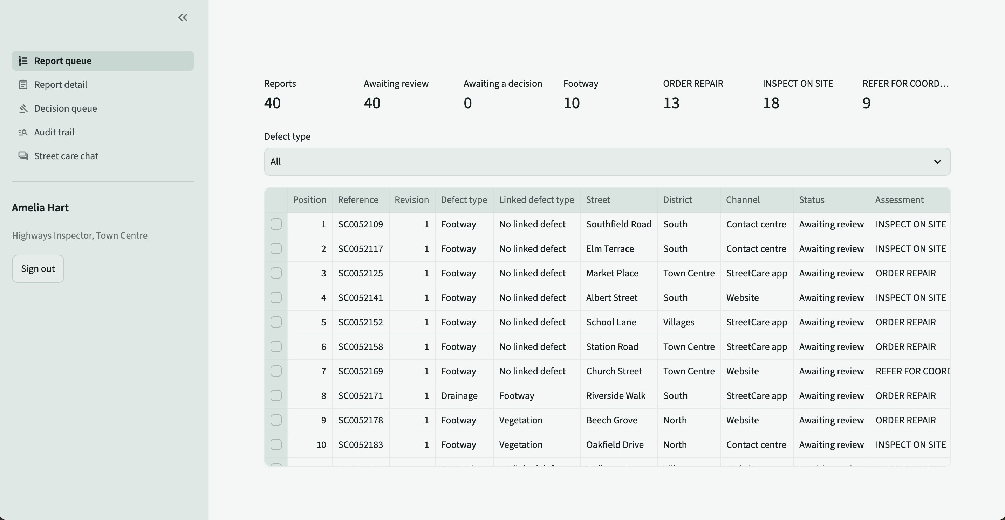
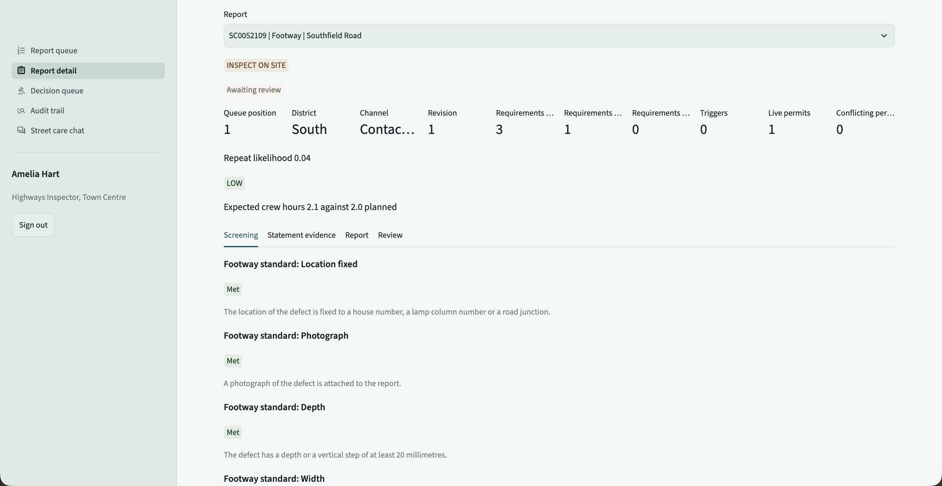
Streamlit dashboard – inspector view
Report queue ranked footway first, and the report detail with its screening
Report queue
Report detail – screening tab
Counts at a glance
Footway first
Every figure from the API
Start a review
reports, awaiting review / decision, each assessment
trip hazards to pedestrians lead the queue
screening, permits, likelihood band, crew hours
one click runs the 5 agents; the page shows 5 calls
24

Slide 25
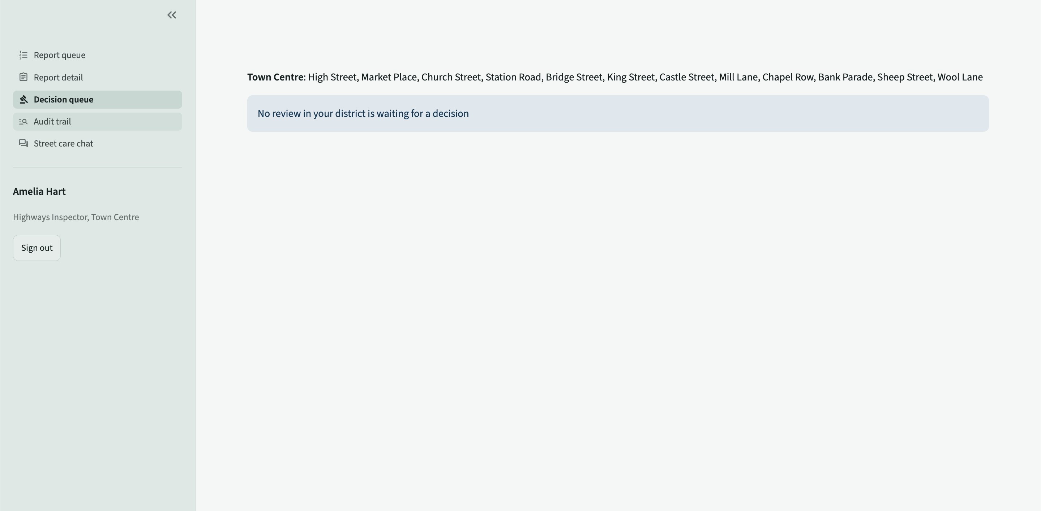
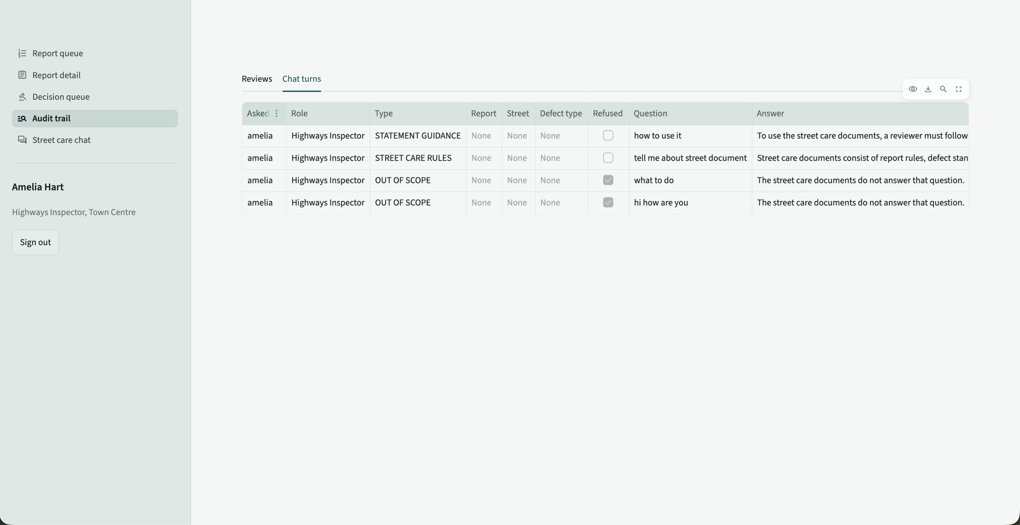
Streamlit dashboard – decision and audit
The inspector decides at the gate; every question and every AI call is audited
Decision queue – own district only
Audit trail – chat turns from everyone
Own district only
Never your own review
Every AI call audited
Every question kept
an inspector sees reviews waiting on their own district's streets
the form is hidden when the inspector opened the review
calls vs expected, tokens and latency for each review
latest 200 chat turns from everyone, with answers
25

Slide 26
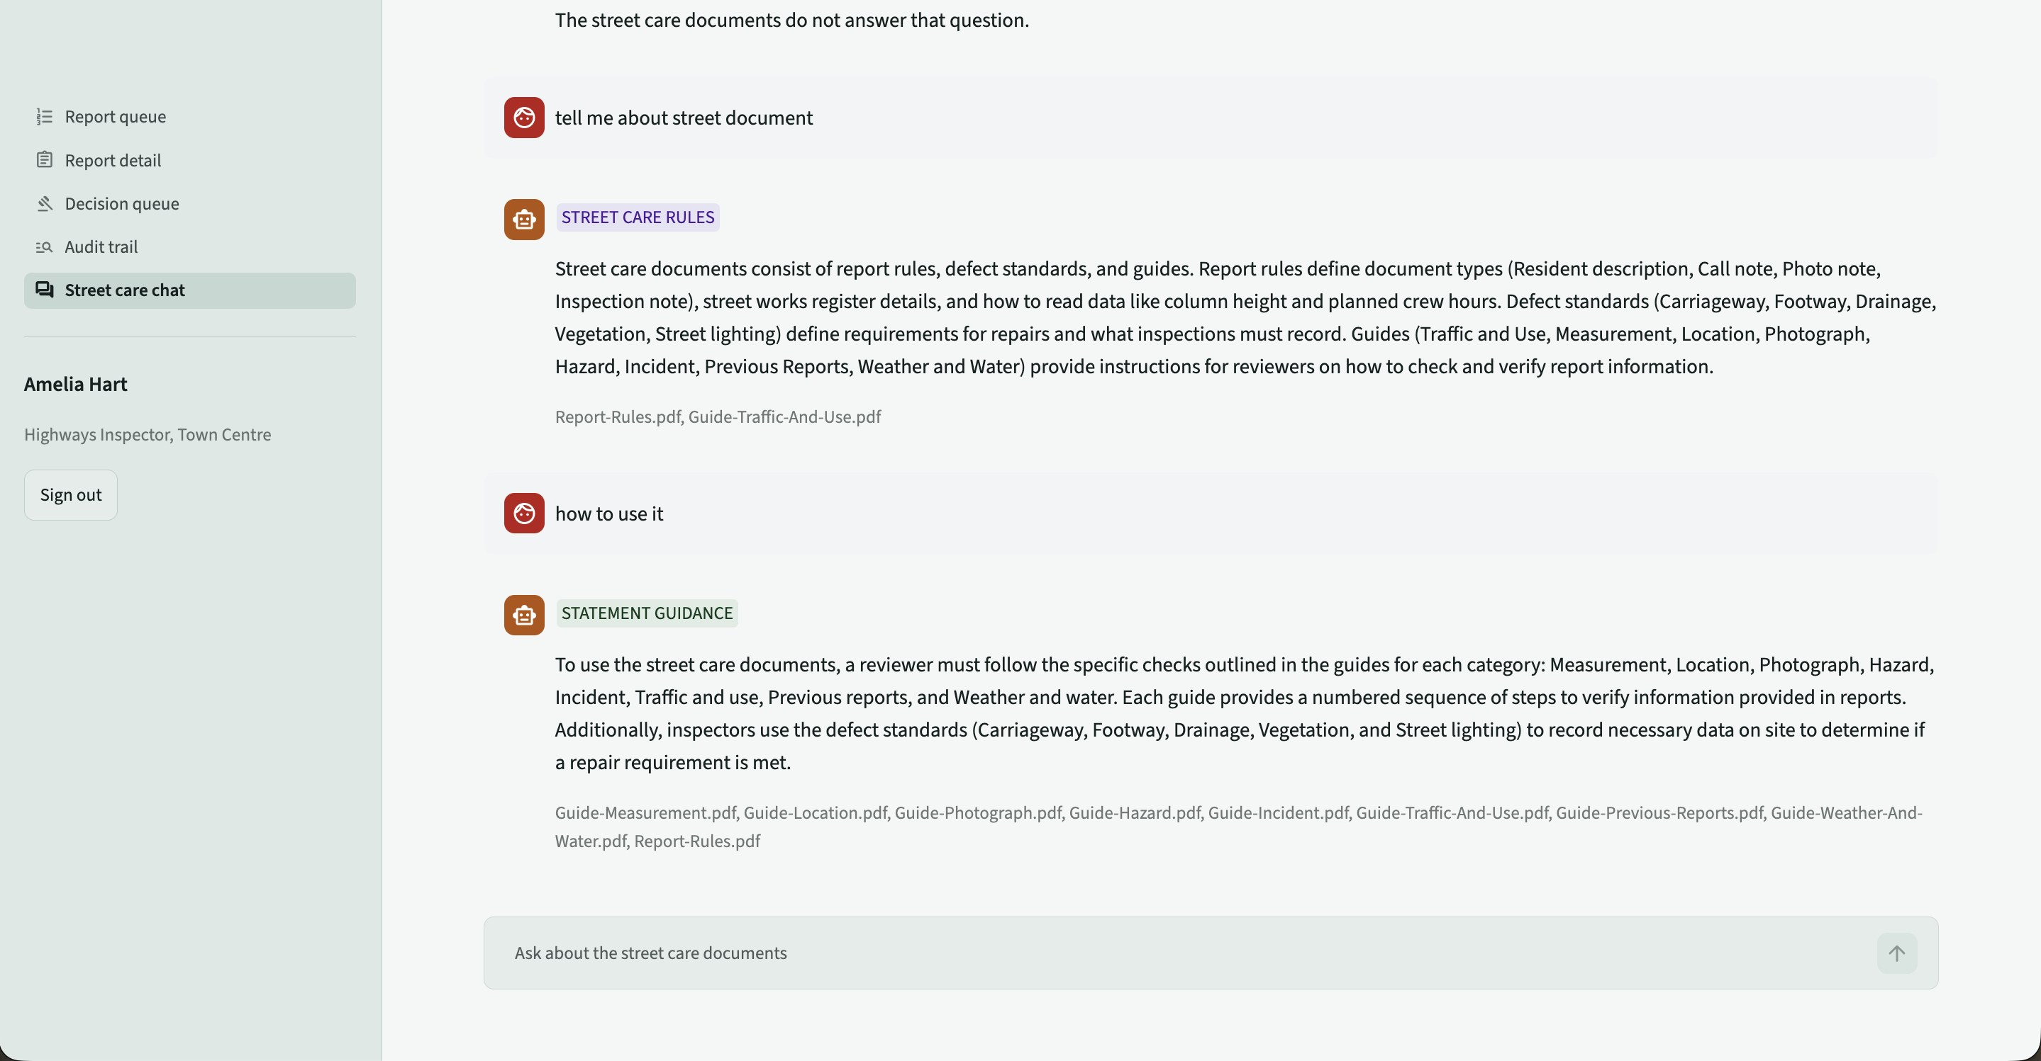
Streamlit dashboard – street care chat
Every answer is badged by question type and cites the documents it came from
Grounded
answers only from the 16 council documents, with sources under each answer
Role-aware
an adviser hears a report's status, never a prediction
Private
street figures below 5 reports are withheld
Audited
every question and answer saved to chat_turns
26

Slide 27
Testing and results
50 automated tests against the real data, models, service and language model
50 / 50
tests pass with the Gemini key
40
pass without it – only the 10 Gemini tests fail
76
API requests captured end to end
Area | Tests | Gemini
Data cleaning | 7 | no
Documents & screening | 15 | no
Features & models | 13 | no
Agents (offline) & figures | 2 | no
Review workflow run | 8 | yes
Chat | 2 | yes
Service & access | 3 | no
Issue encountered | Resolution
3.95 cm rounded to 39 mm | Decimal, half-up everywhere
Chat sources stored as JSON | column changed to Text
Paused runs across restarts | SqliteSaver checkpoint
Agents decorate replies | tolerant labelled parser
Approximate vector search | search breadth = collection
5 people editing at once | one owner per file per day
Missing dependency | installed in setup steps
27

Slide 28
Team and delivery
Five themed days, one owner per file – five branches a day merged without conflicts
Data
RAG
ML
Agents
API & Streamlit
Puttamaneni Srinivasa Praneeth
Riya Rajeev Shinde
Parvathy Vinod K V
Bhavesh Durai S
Mansavi Aggarwal
database · cleaning · quality report · pipeline
PDFs · passages · ChromaDB · standards · screening
features · 3 models · evaluation · benchmark
Gemini client · 7 agents · LangGraph · chat
auth · permissions · REST API · dashboard
Day 1
Day 2
Day 3
Day 4
Day 5
7 tests passing
22 tests passing
35 tests passing
37 tests passing
50 tests passing
How we worked
• Names, signatures and keys fixed by the specification and config.py, so parallel work fits together
• One owner per file per day – each person pushes an individual branch, so the five branches merge without conflicts
• Each day: merge five branches → run that day's build step → run its tests → move on
• No hard-coded values: every threshold, mapping and message lives in config.py
28

Slide 29
Live Demo
One report from the queue to a works order

Slide 30
Closing remarks
What we delivered, what we learned, and where it goes next
Delivered
Learned
Next
End-to-end: data → models → RAG → screening → agents → API → UI
Code decides the facts, LLMs explain them
Calibrated gradient boosting for repeats
All 50 tests passing
Read rules from documents, not code
Per-report explanation of top inputs
Every model above its minimum
Durable human-in-the-loop with checkpoints
Live street works feed and queue refresh
Every figure traceable to a document or model
Clean data matters more than model choice
PostgreSQL, containers, cost dashboards
A person approves every decision
30

Slide 31

Thank you
Questions?

